Slide 1

BUS7C3 International Organisational Branding
Lecture 7 - Cultural Meaning Systems & Brands and Brand Equity

Slide 2

This week’s learning outcomes
At the end of this session, you will be able to:
Explain the cultural meaning of systems and brands
Evaluate semiotics and brand meanings
Relate to brand equity models and theories

Slide 3
Cultural Meaning Systems
How are brands used as signalling systems to create and send meanings of social differentiation and social integration?
To answer this question an understanding of the basic analytical tools of semiotics, or the science of signs, is needed

Slide 4
Semiotics and brand meanings
The signifier and the signified
The signifier—for instance, a brand name—must acquire meaning through associations with other pre-existing meanings until it comes to signify some concept or idea
The signified is a connotative communication, which generates personal associations, overtones, and feel, and can be literally any meaning that can be associated with the signifier, in most cases this occurs through advertising and packaging
Discuss the study of the advertising for beer brands (Harvey and Evans, 2001). Figure 1 Next slide
Indexicality
possessions served as physical evidence, ‘indices’ of a special relationship with people, places, and events

Slide 5
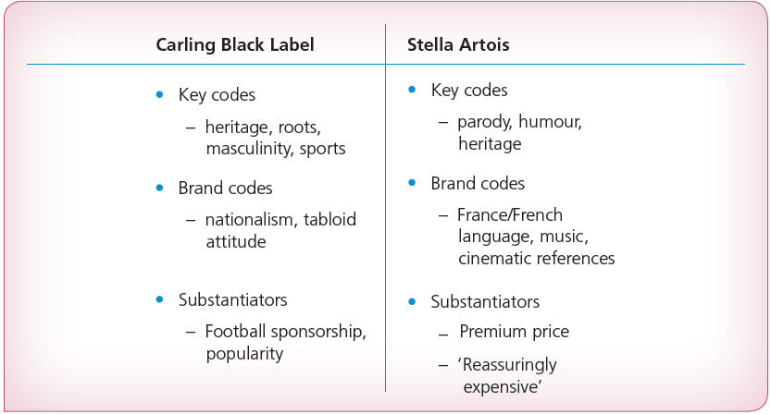
Figure 1: Semiotic analysis of UK beer ads

Slide 6
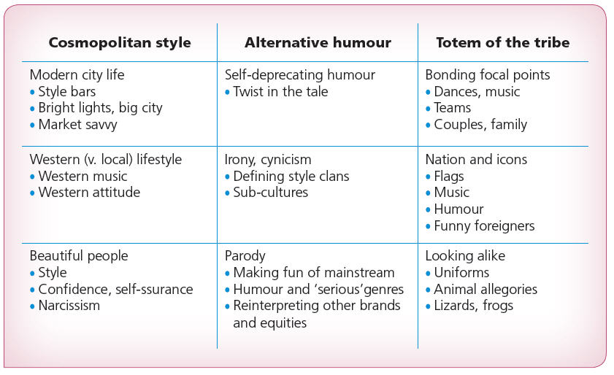
Figure 2: International language of beer advertising—signifiers for three sample codes

Slide 7
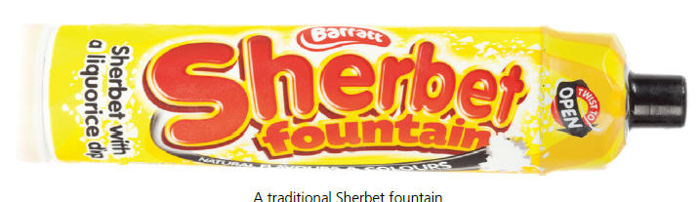
Personal meanings
Brand personality: the brand-as-a-person
Brand relationships: the brand-as-a-friend
Exciting versus sincere
Anxious consumers
Nostalgia
Defined by Holbrook and Schindler (2003) as ‘a preference towards experiences associated with objects that were more common when one was younger’

Slide 8

Social differentiation and social integration
Social integration: the communication value of brands can be thought of as fundamentally integrative, in that knowledge of consumption codes and attendance at consumption events are essential to being included as part of a social group (Slater, 1997)
Brand communities
Neo-tribes
Sub-cultures
Aikido brands

Slide 9
Brand equity
The resonance of a name
The difficulty of defining brand equity…
49 different studies in US and Europe produces 26 different measures (Sattler, 1994)

Slide 10
Financial perspective
Companies with strong brand names can sell for more than 20:1 of firm’s earnings
Strong brands = less risk
Greater likelihood of a solid income stream
Higher market share leading to higher price/lower costs and less price elasticity
Better margins higher ROI
More effective distribution
Shelf space
Pulled through the chain by consumers leading to retailer and wholesaler demand
See Fig 3, next slide

Slide 11
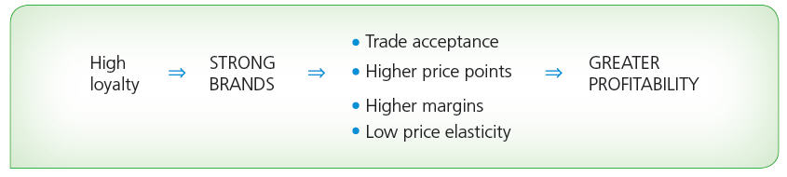
Figure 3: How strong brands generate greater profitability

Slide 12
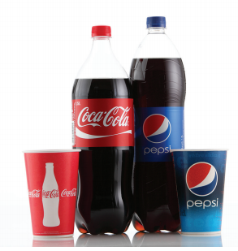
Consumer perspective
Understanding brand equity must come from the consumer’s point of view
Brand equity is the (1) awareness of a brand which leads to (2) learning about the brand and forming attitudes about the brand. These occurrences are influenced by emotional associations, and they create (3) preferences for the brand, which builds brand loyalty

Slide 13
Brand awareness
Strong brand awareness reflects
Familiarity
Presence
Commitment
Substance
A person must have the intention to make a branded purchase within a product category for awareness to matter

Slide 14
Brand awareness
Broadly speaking brand awareness can take two forms
Recognition (e.g. fast-moving consumer goods (FMCGs))
Recall (e.g. a restaurant)
The brand must be salient

Slide 15
Brand attitude
Associations in memory are linked to the brand
These should be strong, positive and unique for loyalty to result
Attitudes are a function of objective and subjective interpretations of the brand
Objective: A person identifies attributes which are product or non-product specific objective characteristics of the brand. These may be translated into benefits depending on the personal values attached by customers to the attributes
Subjective: Perceptions of a brand’s personality or symbolic meaning
See Figs 4 and 5, next slides

Slide 16
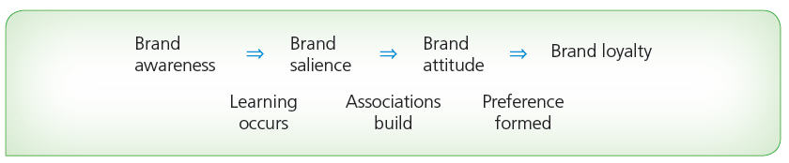
Figure 4: Brand awareness, salience, and attitude leading to brand loyalty

Slide 17
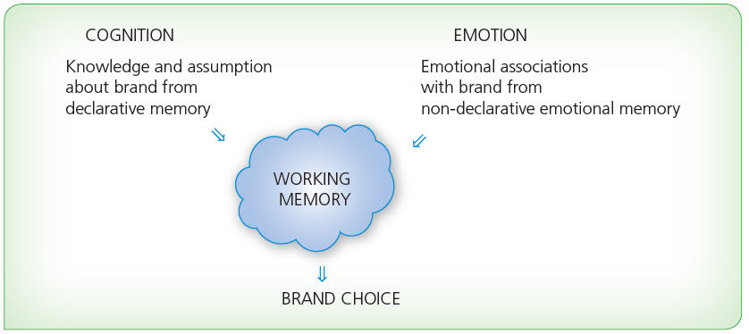
Figure 5: Interaction of cognition and emotion in making brand choices

Slide 18
Brand loyalty
Like financial value, brand loyalty is a consequence of brand equity
Habit versus genuine preference
Habitual preference is usually based on functional benefits and may lead to brand equity if satisfaction can be maintained
Loyalty is not assured
Genuine preference contributes to brand equity and if that transcends rational preference then it is sustained by brand equity
See Figs 6 and 7, next slides

Slide 19
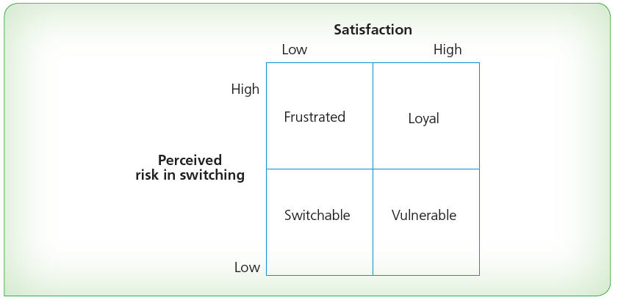
Figure 6: Percy and Rosenbaum-Elliott Brand Loyalty Model

Slide 20
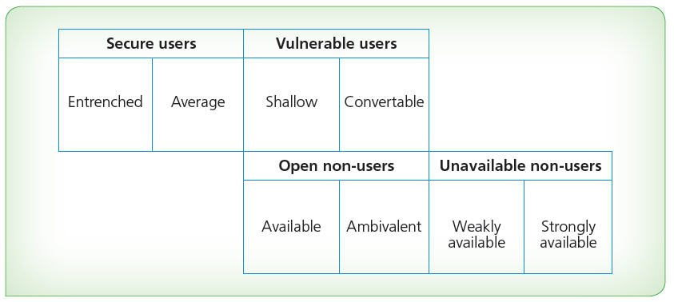
Figure 7: Hofmeyr Conversion Model for mature fmcg markets

Slide 21
The central role of brand equity
Brand equity is a central construct in the strategic management of brands. When managing brands it is important to acknowledge the difference between functional and symbolic brands. Many of the relationships discussed in these slides are shown in Fig 8, next slide

Slide 22
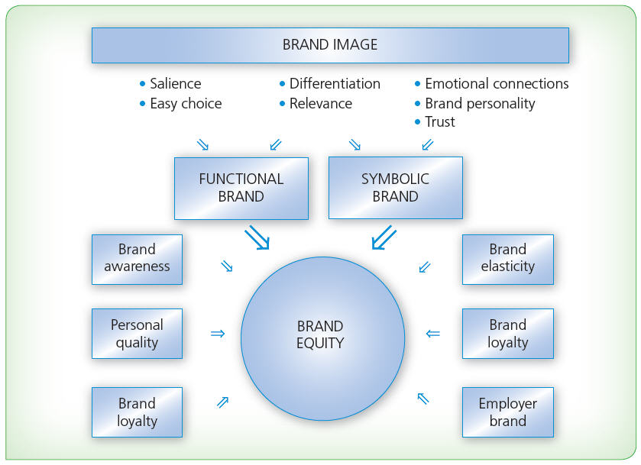
Figure 8: A synthetic model of brand equity

Slide 23

Thank you!
Any questions?

